Slide 1
HEALTH INFORMATICS PUBLIC PRIVATE PARTNERSHIP Project in Cambodia
Mr. PHATH VEASNA
National Center for HIV/AIDS,
Dermatology and STD
CKCC, 19th November 2013
Notes:
By the cooperation from NCHADS with USCD and get approve from MOH this project has created and out source from INSTEDD.
Project Partners
NCHADS
INSTEDD
US-CDC (OGAC/PEPFAR)

Slide 2
Project Goal
Use technology in Health Information System to support improvement of quality of health services delivery in Cambodia’s National HIV Care and treatment program.

Slide 3
Project Objective
Improve the linkages and referrals between differences services through linking of existing health information system with a patient unique identifier system.
Promote the use of data from this new integrated system to monitor and improve the quality of services

Slide 4
Duration of Project and Location for Implementation
Duration of the project:
- Develop software: 1st April 2012
- Implement: Mid March 2013
Location: Battambang Province
5 OI/ART Services
16 VCCT Services
2 STD Services
OI/ART: Opportunistic Infection/ Antiretroviral Therapy
VCCT : Voluntary Centers for Counseling and Testing
STD: Sexually Transmitted Disease
Notes:
. National Ethic approval on December 2012

Slide 5
Data Integration
Objective: To link VCCT, OI/ART and STD information for improved patient care
How: Use Master Patient Index (MPI) and Fingerprint
Notes:
What will this project affect the current workflow at the site?
Finger print scanning will be add to the current registration process.
Provide consent to the patients for taking their finger print

Slide 6
Why Fingerprint ?
Universality, High uniqueness, high permanence, low cost compared to other biometric.
Use fingerprint template for identifying. Fingerprint template could not be reversed.
Template size: 3000 byte
Speed: 1:20000 → 4 seconds
1:50000 → 9 seconds
Biometric
Minutia
Data
Notes:
Universality – Everybody have fingerprint
High permanence- Fingerprint not change if we do nothing that touch that fingerprint
Uniqueness – everybody does not have the same fingerprint
Permanance – algorithm of verify fingerprint become faster and more accurate

Slide 7
Feature
Patient search
Patient registration
Synchronization
Security System
View patient
Notes:
Synchronization
1- When there’s no connection to server, data are entered and stored locally
2- When connection to server is restored, the nurse or clinician clicks on the ‘Synchronization’ button, which syncs the local data with the master data.
Security
1- Virtual Private Network
2- User’s fingerprint and side code are required for all requests to server

Slide 8
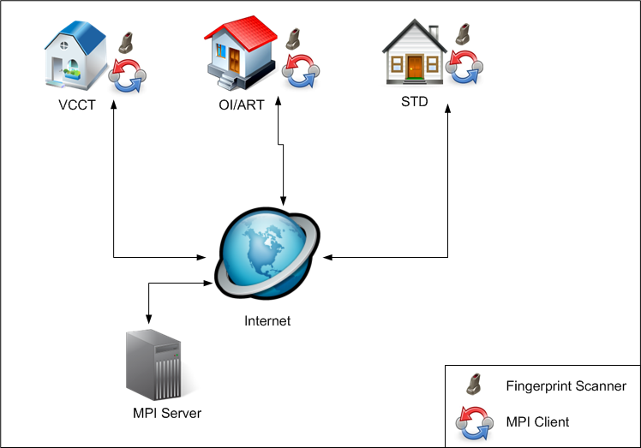
Information flow
Notes:
Data saved in local and server.
When he goes to another service, we can extract information from server, and we know that he used to go to other service

Slide 9
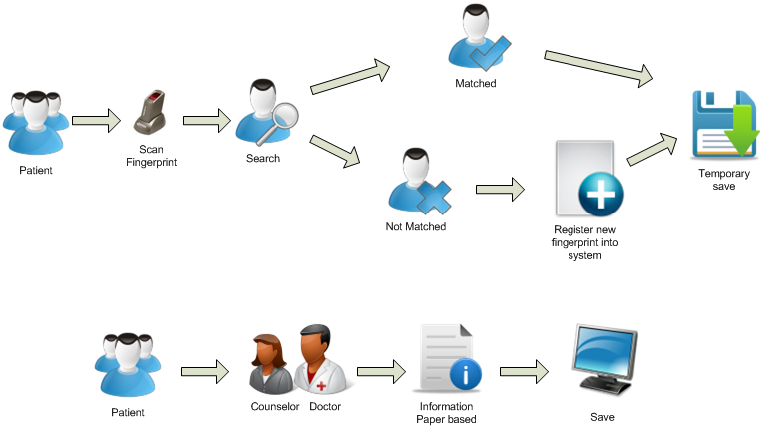
Process detail
Notes:
What will this project affect the current workflow at the site?
Finger print scanning will be add to the current registration process.
Provide consent to the patients for taking their finger print

Slide 10
New Information provided by the system
Duplicate HIV Test rate
- Average number of HIV tests per clients
Linkage to Care rate
Rate of patients who test HIV-positive at the VCCT who register at OI/ART
Rates of VCCT / STI Referral
- Rate of patients who positive for an STI who later to get an HIV test at VCCT
- Rate of patients who test HIV-positive at VCCT who later register at an STI clinic for STI test

Slide 11
Actionable Data
List of patients who were not linked to care – i.e., patients who tested HIV+ at the VCCT site who never registered at OI/ART site
List of patients who referred to STI but not yet show up at the STI clinic
List of patients who referred from STI to VCCT for HIV testing but now yet show up

Slide 12
Result of OI/ART, VCCT and STD after deploying MPI
1- OI/ART
Date Start | To Date | Number of patients | Shown at STD
01/04/2013 | 14/11/2013 | 5979 | 29
2- VCCT
Date Start | To Date | Number of clients | Positive | Shown at OI/ART | Shown at STD
01/04/2013 | 14/11/2013 | 7600 | 270 | 106 (39%) | 80 (30%)
3- STD
Date Start | To Date | Number of clients | Shown at VCCT
01/04/2013 | 14/11/2013 | 1951 | 230
4- Clients Tested Duplicate at VCCT
Date Start | To Date | # of clients who tested 2 times | #of clients who tested 3 times | #of clients who tested 4 times
01/04/2013 | 14/11/2013 | 122 | 10 | 1
Notes:
Result of each site after deployment

Slide 13
Key Benefits
Better patient follow up through improved health care services
Provide actionable information to stakeholder

Slide 14
Challenges
Some specific problems related to revised source code of Fingerprint SDK met error like increase memory then get stuck so need to get the answer from provider and take long time to get response.
Sometimes Fingerprint not working properly
Workflow place to place is different and not exactly the same as we have known
Some sites has problem with Internet connection or Internet slow.
Unstable electricity which UPS cannot work for long hours

Slide 15
Lesson Learn
Patient flow is different from sites to sites. We need slightly modify our setup and system to fit with flow.
Create patients fingerprint for temporary first before to see doctor or clinician
Data entry can entry the patients/ clients information after patients from completed by doctors or clinician
Computer knowledge of users are limited. However, the problem can be solved with additional training on basic computer
Some of the sites just start using electronic databases. Need more time to adapt to the system.

Slide 16
Acknowledgements
NCHADS
MoH
US-CDC (OGAC/PEPFAR)
InSTEDD
DDD Committee

Slide 17
THANK YOU!

